Slide 1


Slide 2
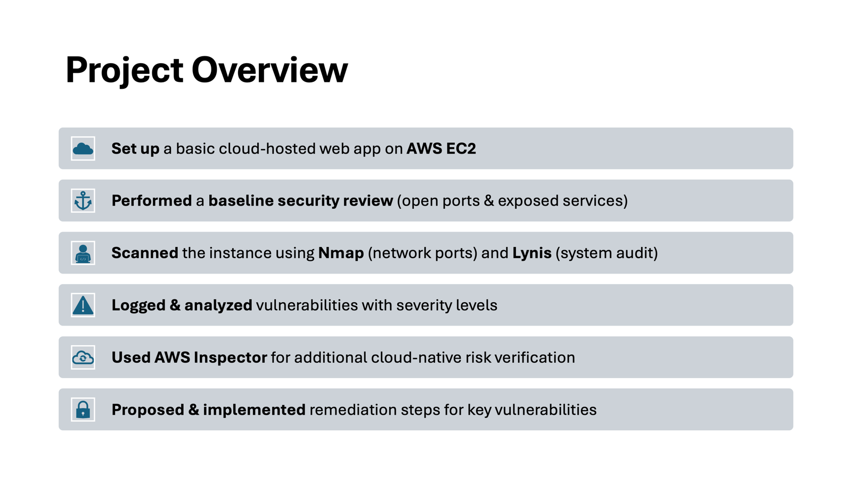

Slide 3
Set up a cloud-hosted web by AWS EC2

Slide 4
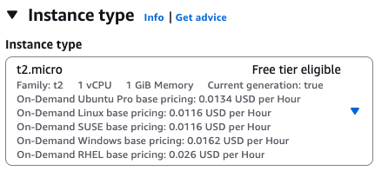
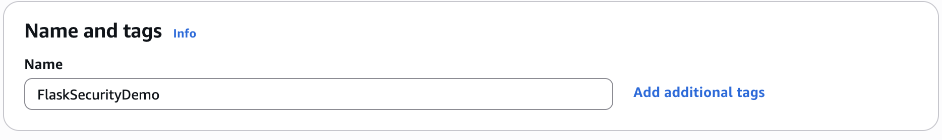
Cloud Setup - Step 1 Launch EC2 instance
Cloud Provider: Amazon Web Services (AWS)
To get started, launch an Amazon EC2 instance, which is a virtual server in the cloud.
Instance Name: FlaskSecurityDemo
Instance Type: t2.micro (Free Vitrual Server)

Slide 5
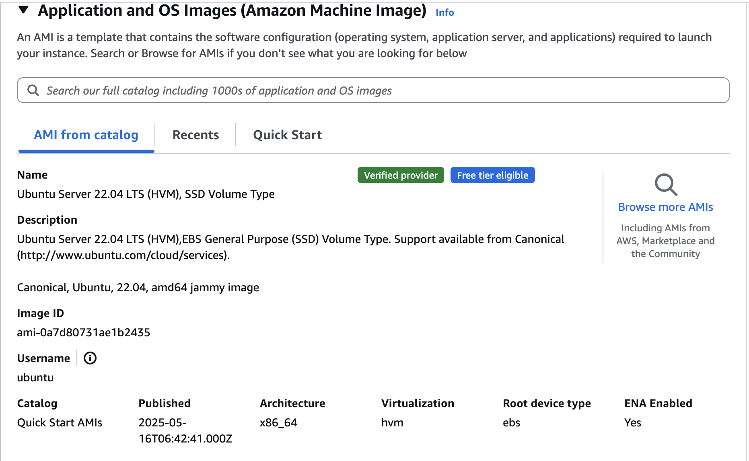
Cloud Setup - Step 2 Amazon Machine Image
An Amazon Machine Image (AMI) contains the operating system, application server, and applications for instance.
AMI: Ubuntu Server 22.04 LTS (64-bit x86)

Slide 6
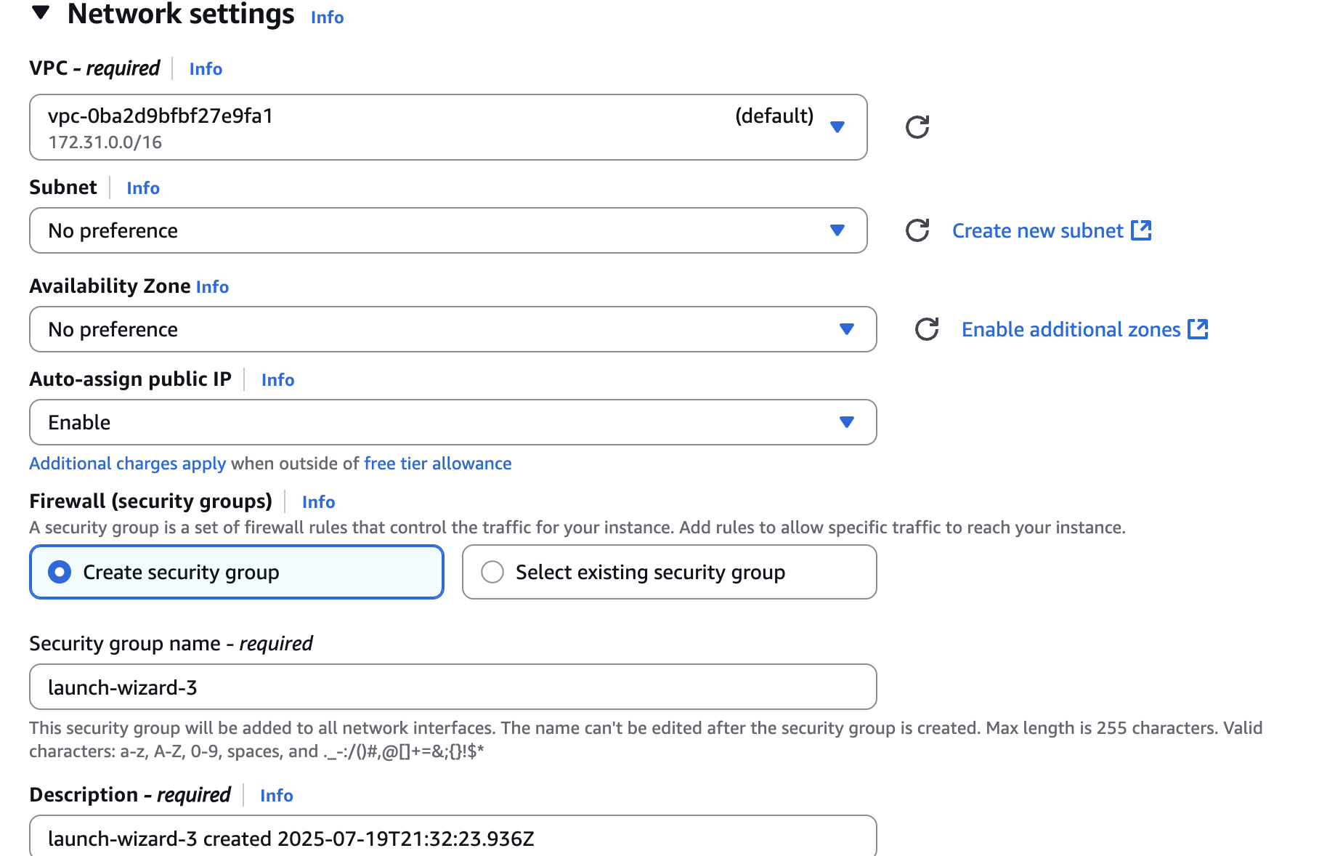
Cloud Setup - Step 3 Network settings
Purpose: EC2 instances can be accessed directly in the browser.

Slide 7
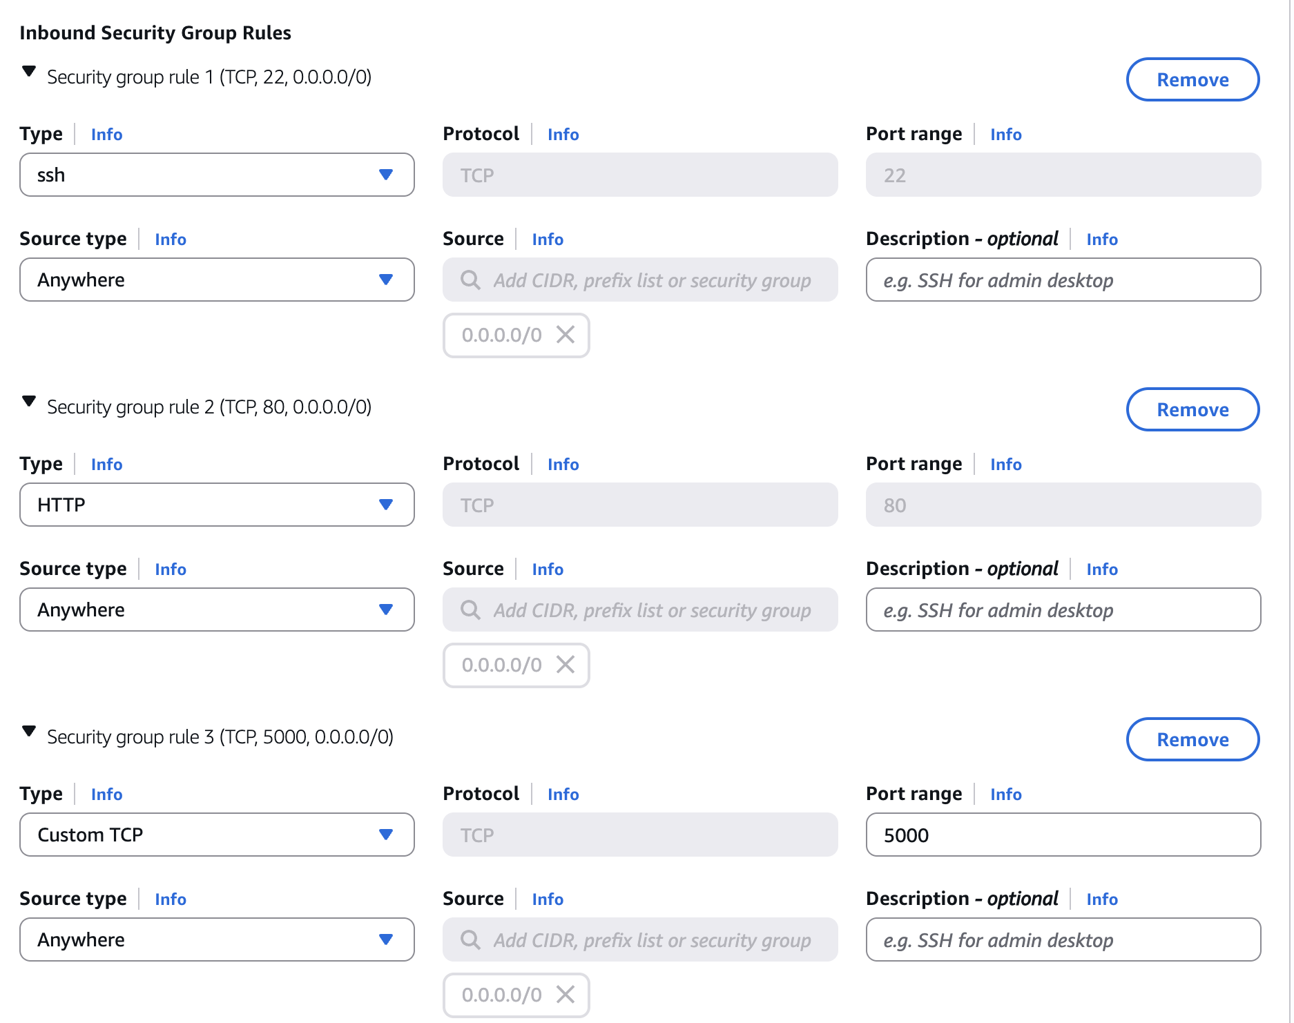
For the firewall (security groups), we defined three inbound rules to control.
Rule | Type | Port Range | Source | Purpose
1 | SSH | 22 | Anywhere | Allow remote login to the EC2 instance using SSH
2 | HTTP | 80 | Anywhere | Allow access to the default web page of the web application
3 | Custom TCP | 5000 | Anywhere | Allow access to the Flask application default port

Slide 8
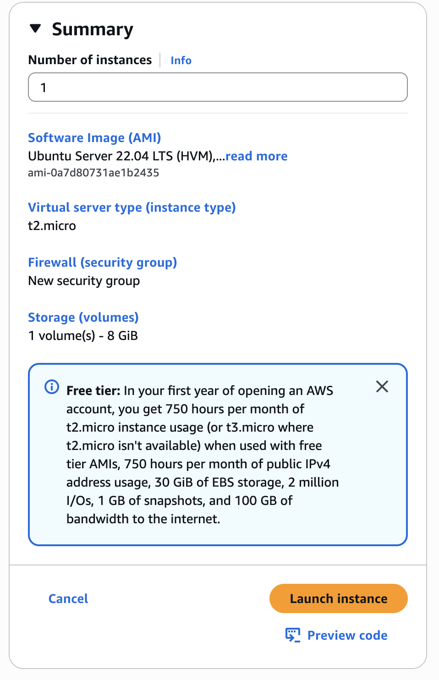
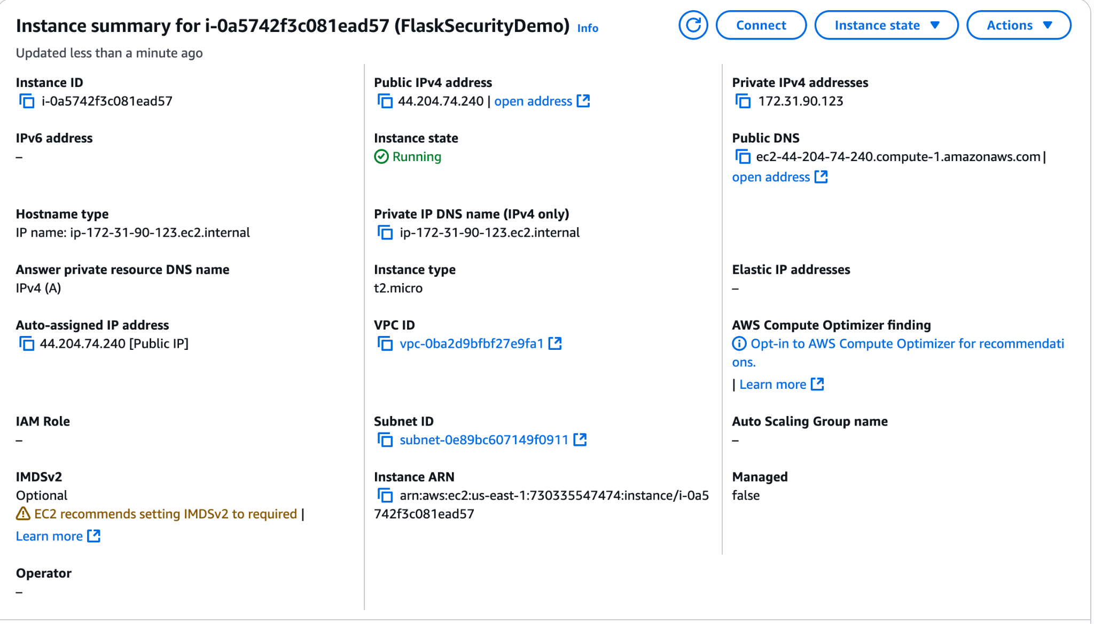
Cloud Setup - Step 4 Launch and Summary

Slide 9
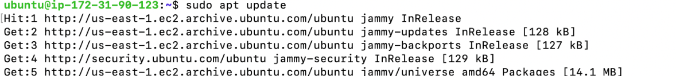
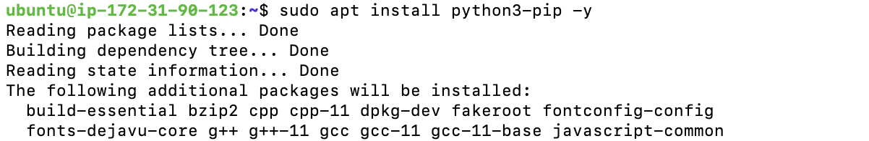
Update & Install Python 3
Step 1: Update the list of available packages.
Prepare the system for installing the latest software.
Step 2: Install pip for Python 3.
To enable to use Python packages like Flask.

Slide 10
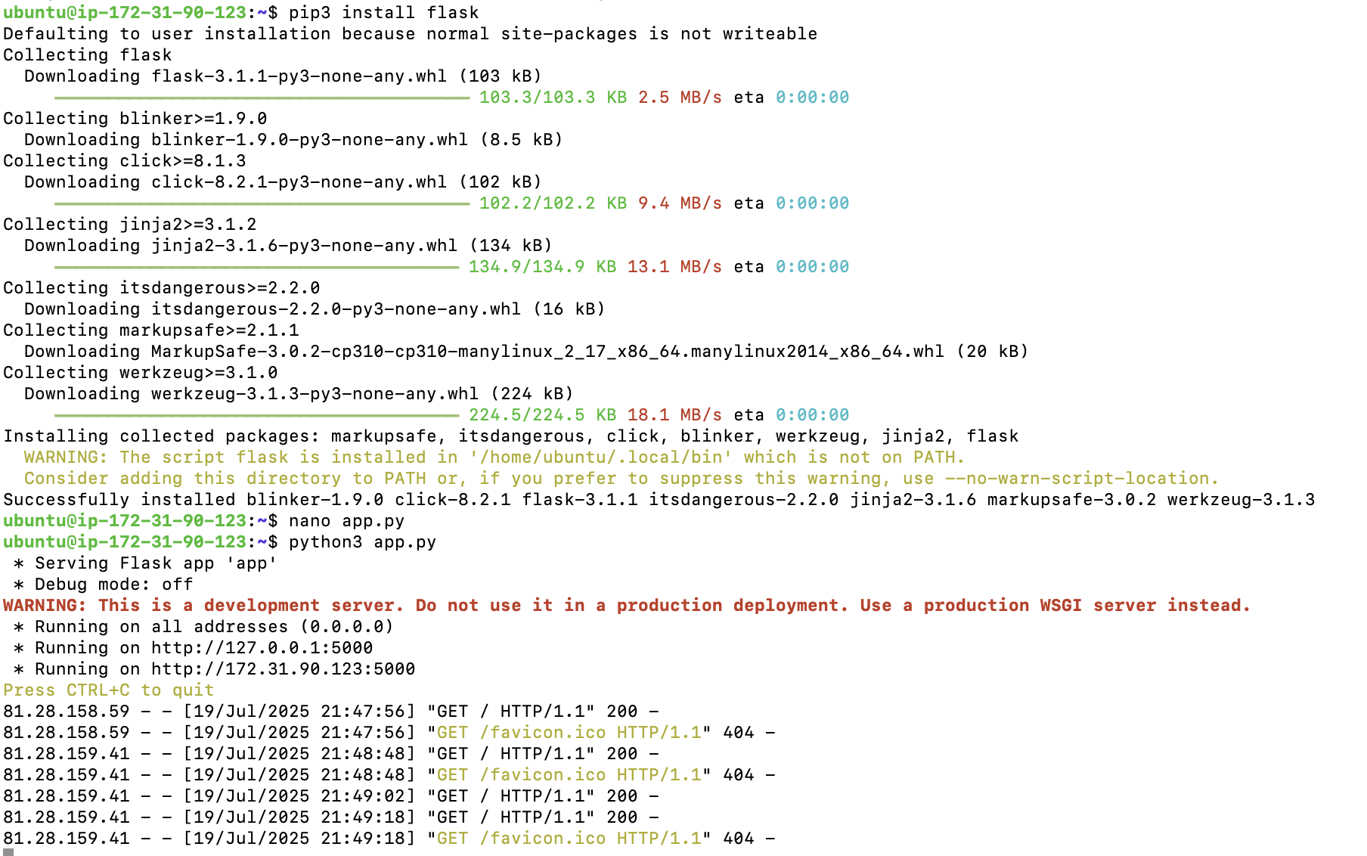
Install & Run Flask
Step 1: Install Flask by following command.
Step 2: Run Flask web application by app.py.
Flask starts a built-in development server and running on: http://127.0.0.1:5000/
This means the server is running locally inside the EC2 instance.

Slide 11

Application Output
Public IPv4 Address: 44.204.74.240
URL：http://44.204.74.240:5000/
In this part,we successfully deployed a basic Flask application on EC2 instance, configured initial firewall settings, and ensured public accessibility via port 5000.
This foundational setup will support further stages of vulnerability scanning, risk analysis, and remediation.

Slide 12
Conduct a baseline security review of the deployment

Slide 13
What is a Baseline Review
A manual, foundational security inspection performed before any automated scanning.
Why it's the first step: "low-hanging fruit"
Identify obvious, easy-to-fix issues
Catch critical risks automated tools might miss

Slide 14
Our Methodology: Simple, Effective Commands
We focused on two key areas: network exposure and running services.
Inspecting Open Ports:
Command: sudo ss -tuln
Purpose: To see exactly which network ports were listening for connections from the internet.
Auditing Running Services:
Command: systemctl list-units --type=service --state=running
Purpose: To identify every process and service running on the server.

Slide 15
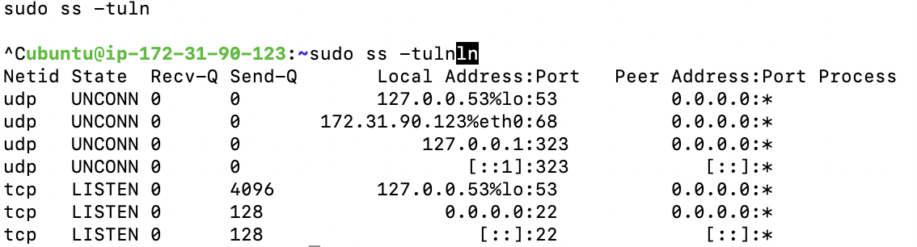
Findings - 1: Network Exposure
Our port scan revealed two key findings:
The Critical Risk: SSH access was completely unrestricted, leaving the server vulnerable to brute-force attacks from anywhere in the world.
No unexpected ports, like for a database, were open.
Port | Service | Exposure | Risk
22 | SSH | Open to the World (0.0.0.0/0) | High
5000 | Flask App | Exposed when running | Medium

Slide 16
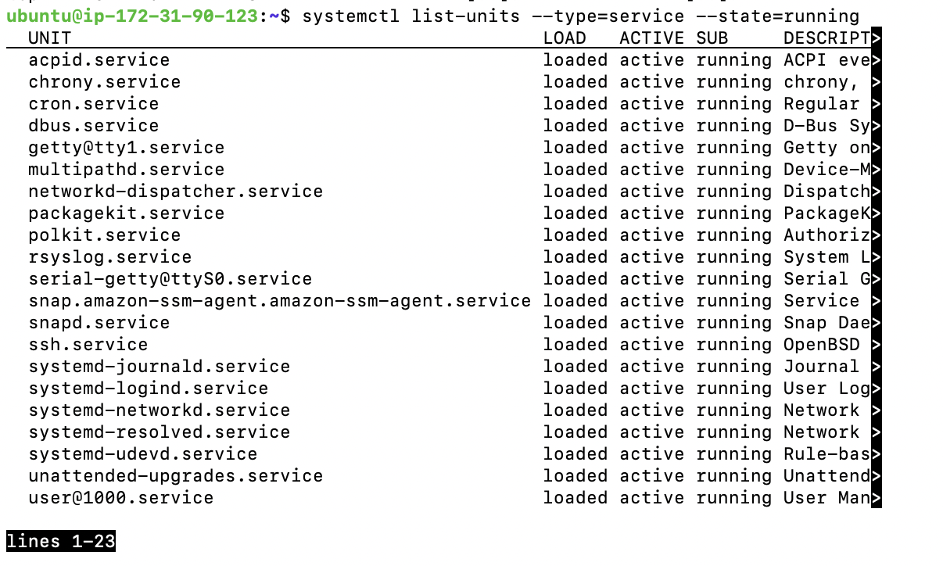
Findings - 2: System Services
The audit of running services showed:
Expected Services: All core system services (systemd, cron, rsyslog) and the required AWS management agents (snap.amazon-ssm-agent) were running correctly.
Unnecessary Services: multipathd & packagekit, active but not needed for our application.
Risk: While low, these services increase the system's potential "attack surface."
No suspicious or unauthorized third-party software was found.

Slide 17
Key Recommendations
Based on our baseline review, we made two immediate recommendations:
Lock Down SSH: Immediately restrict SSH access in the AWS Security Group to allow connections only from trusted IP addresses. This follows the principle of least privilege.
Reduce Attack Surface: Disable the unused multipathd and packagekit services.
Conclusion: This initial manual review was fast, simple, and revealed critical vulnerabilities that we could address before moving on to deeper, automated scans.

Slide 18
Run vulnerability scans using tools by Nmap

Slide 19
What is Nmap?
Nmap (Network Mapper) is a free, open-source tool used for:
Network discovery
Security auditing
Port scanning
Service/version detection
Operating system fingerprinting

Slide 20
What do Nmap do?
Nmap scans a target host (like a server or a group of IP addresses) and tells you:
Which ports are open, closed, or filtered
What services (e.g., SSH, HTTP, FTP) are running
What versions those services are

Slide 21
Why is important in Security?
Security professionals and ethical hackers use Nmap to:
Check for unintended exposed services
Find vulnerable open ports
Perform preliminary reconnaissance in penetration testing
Misconfigured or forgotten services can be exploited
Nmap helps detect them before attackers do.

Slide 22
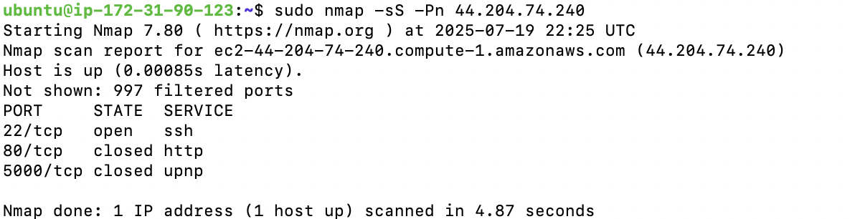
Scan Using Nmap
Purpose: This uses the Nmap tool to scan the target server (44.204.74.240) to detect which ports are open and what services are running.

Slide 23
Use Lynis to audit the system
security auditing tool
sudo apt install lynis -y
sudo lynis audit system
Purpose: This uses the lynis security auditing tool to analyze the system for potential vulnerabilities or misconfigurations.
It checks the system’s:
Installed packages
Firewall configuration
Security settings
Kernel options
File permissions, and more

Slide 24
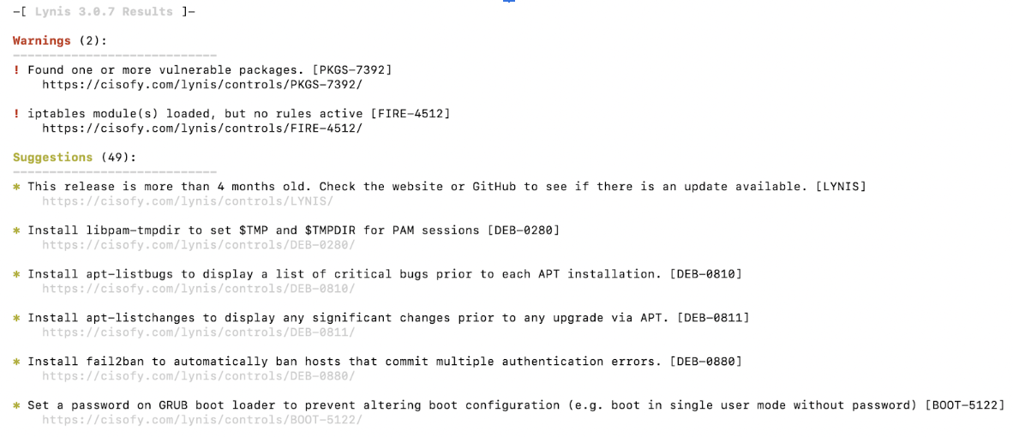
Lynis Result

Slide 25
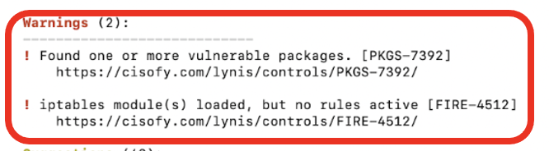
Log the vulnerabilities and analyze severity
vulnerabilities | Severity
PKGS-7392 | ⭕️HIGH
FIRE-4512 | ⚠️Medium
Recommendations:
Critical: System release is outdated.
Firewall: No firewall rules are active despite the iptables module being loaded. This exposes the server to unnecessary risk.

Slide 26
Use Cloud-Native Tools to Verify Risks & Remediate Key Vulnerabiloties

Slide 27
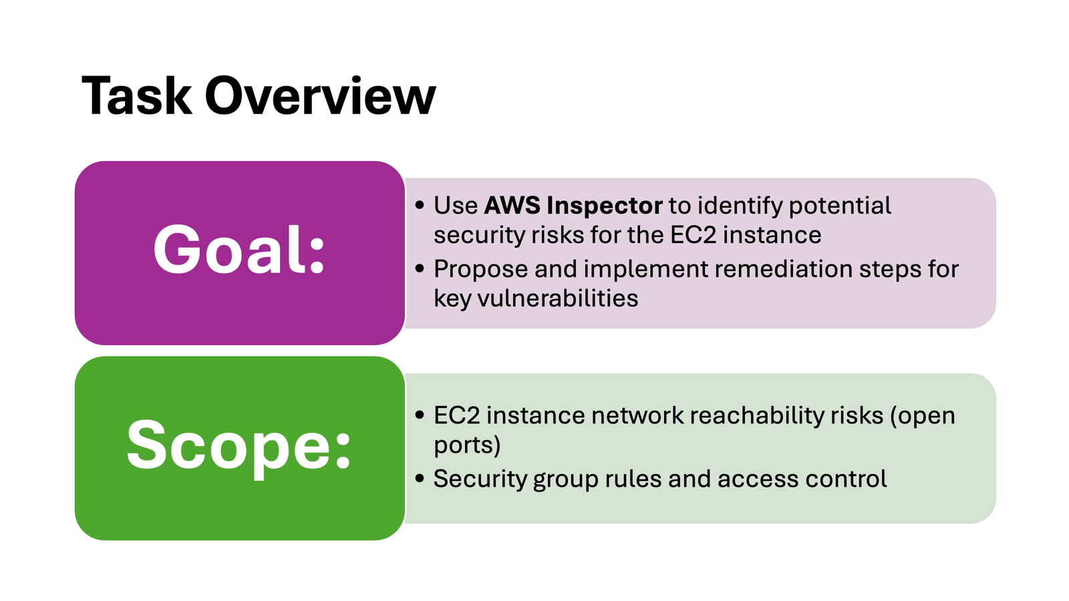

Slide 28
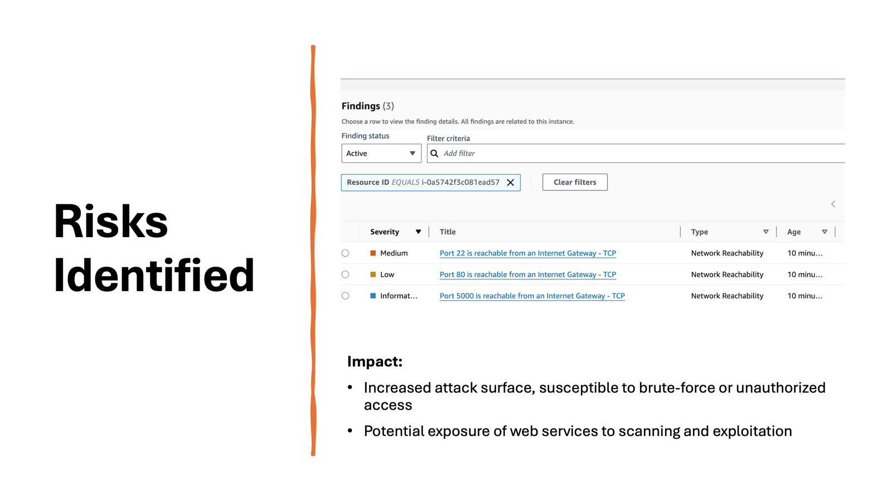

Slide 29
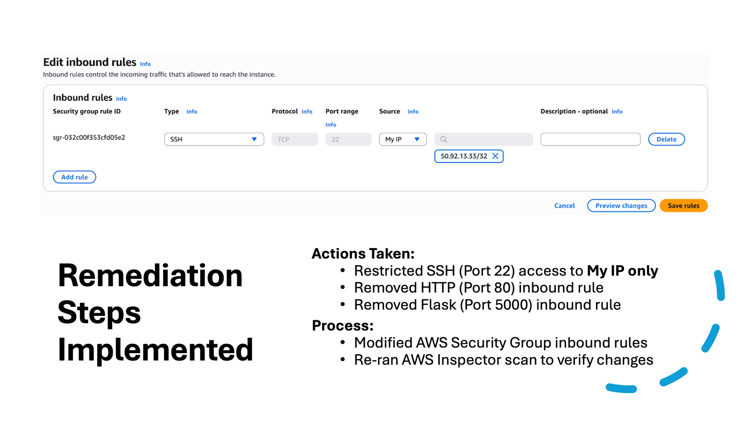

Slide 30
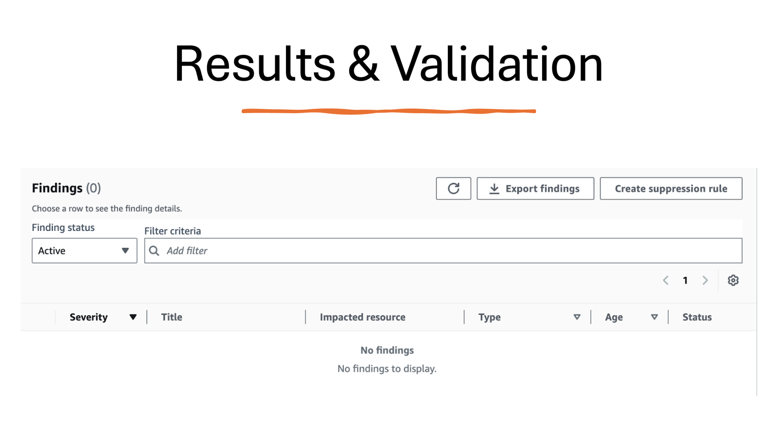

Slide 31


